Slide 1
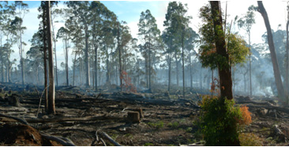
Panoramic Photography
Greg Looker
17 Aug 09

Slide 2
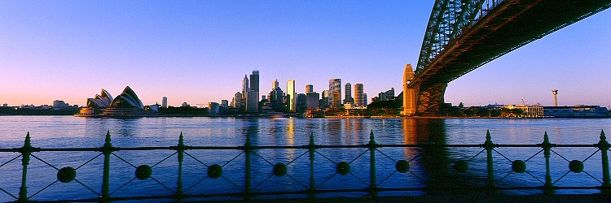
Max Taylor panoramas© 211 Balgowlah Road, Balgowlah NSW 2093 Australia Phone: +61 2 9948 7400 Email: info@maxtaylor.com.au

Slide 3
Max Taylor panoramas© 211 Balgowlah Road, Balgowlah NSW 2093 Australia Phone: +61 2 9948 7400 Email: info@maxtaylor.com.au

Slide 4
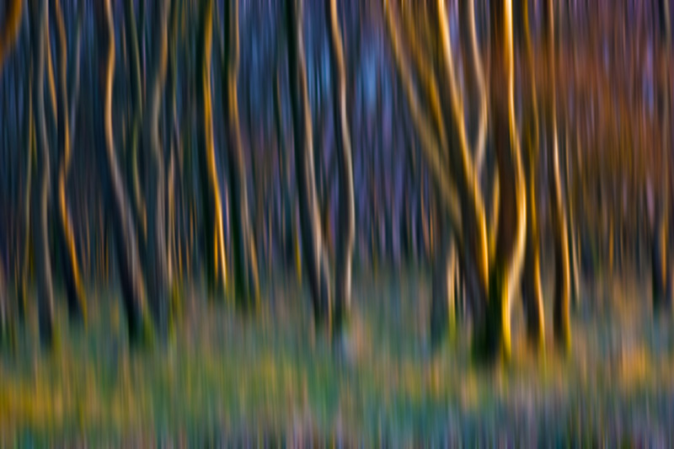
Introduction
Panoramic pictures scream special to me.
No uh moments
Invite discussion
Notes:
As you know I like panoramoic pictures and volunteer to give this talk. I do not believe I am an expert and I hope this presentation will more discussion rather than me telling you how to do it. I don’t believe there will be any uh moments this evening. I hope there is but my task tonight is to focus on panoramic shots.
About me
So what will we be discussing tonight.

Slide 5
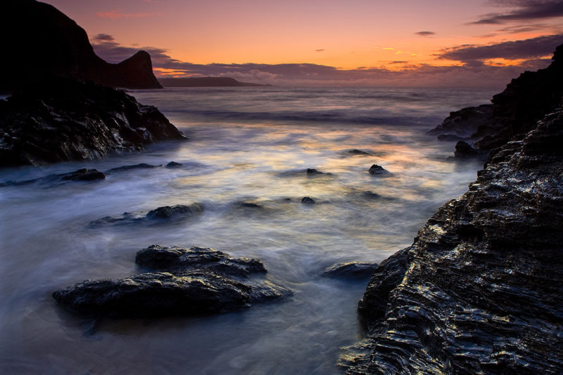
Scope
Introduction
Equipment
Considerations
Taking the photo
Available Software
Merging
Finished Product

Slide 6
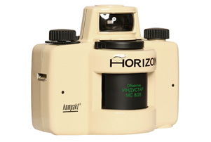
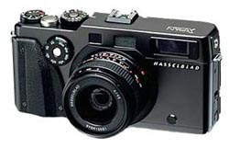
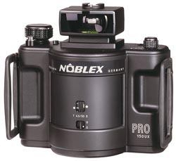
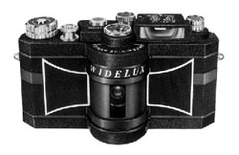
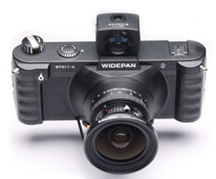
Equipment
Notes:
ROTATING LENS CAMERAS sorted by price
These cameras feature a rotating lens. Cocking the Horizon's shutter charges its clockwork mechanics, and touching the shutter release sets the lens into motion. As the lens swings from side to side, a narrow vertical slit between the lens and film rotates along with it - thereby progressively exposing the film as the lens moves. The film plane is curved, thereby keeping the film tight and maintaining a uniform distance from the lens.
Lomographic Horizon Kompakt Rotating Lens 35mm Panorama Camera At the heart of this system is a 28mm lens that features multicoated glass lens elements, which produce crispy, full-contrast images. Every shot that you take has f/8 automatically dialed in. For ease of use, the Kompakt offers just two settings: The day setting shoots at 1/60 second, and works in full sunlight to partial shade. The night setting gives you 1/2 second, enough to make a softly lit street scene absolutely glow with color and shine. Price : $ 289.95
Widelux F8 35mm Smaller 35mm version of its big brother, offering a slightly shallower 140° angle-of-view, but also a much lower price tag. The camera works on the same rotating lens principle using a 26mm lens to create the 24x59mm exposures per film. Price : $ 1,649.95 (recently reissued)
Noblex Pro 150 UX There are three variations of this 120 medium-format camera available. All have the basic Pro 06/150 specification, which includes a rotating 50mm f/4.5 Tessar lens that travels through a complete 360° to ensure a consistent speed, and a 146° angle-of-view. They all give six 50x120mm images on a roll of 120 film and have a shutter speed range from 1/30sec to 1/250sec. The difference between the standard Pro 06/150E and the Pro 06/150FE is that the latter has three focusing distances. The Pro 150UX adds a 3° shift and an extended shutter speed range. Price : $ 3,899.95
WIDE-ANGLE LENS CAMERAS sorted by price
These cameras use very wide angles lenses coupled with very wide film formats to produce their panoramic photographs. They range in format from 35mm to 6 x 12 and 6 x 17 cm using lenses as wide as 30mm.
Hasselblad Xpan 35mm It seems like an unusual move for the medium-format masters Hasselblad to produce this 35mm format camera. The XPan is a dual-format model that offers conventional 24x36mm images but also provides a 24x65mm panoramic format that can be switched mid-roll. The camera has interchangeable lenses and its 30mm, 45mm and 90mm lenses have medium-format characteristics providing large image circles to ensure even illumination across the full panoramic format. A bright-frame viewfinder and coupled rangefinder are used to compose and focus images and an optical finder is supplied with the 30mm f/5.6 Aspherical. This camera has all the features of a typical 35mm model including auto film advance at up to three frames per second, DX coding, TTL exposure meter, with centre-weighted readings, an aperture-priority mode and an LCD display that shows exposure info. [Fujifilm also sells this camera in Japan as a TX-1.] Price : $ 1,699.00
Fuji GX617 One of the most desirable panoramic cameras with sophisticated looks and a great feel - just what you'd expected from a Japanese design. The GX617 delivers four 6x17cm shots on 120 film or eight on 220, and has a choice of three interchangeable lenses. The 90mm f/5.6 offers a generous 89° angle-of-view for the interior photographer and creative landscapes, the 105mm f/8 with its 80° coverage is perfect for general landscape shoots and the 180mm f/6.7 offers a more sedate 52° view. Telephoto photographers will prefer the more powerful 300mm f/8 telephoto. Each lens has an integral shutter with speeds from 1-1/500sec, offering flash sync at all speeds and a B-setting. Price : $ 2,499.00 used (now discontinued)
Widepan WP617 The Widepan WP617-A fills the gap the Art Panorama left perfectly; a very well made and finished camera body with no useless features. And in case you hadn't already noticed, it looks very similar to the wonderful (but not cheap) Linhof 617. It is a fixed lens model, equipped with a dedicated 90mm Super Angulon lens, and offers indexed film transport with both 120 (4 exp) and 220 (8 exp) film. It is supplied with a matching viewfinder with internal spirit levels, and comes with an alloy storage case. An optional focusing screen is available, as is the Schneider Centre Filter which is necessary to correct for illumination fall off at the edges of the field. Price : $ 3,435.95

Slide 7
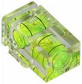
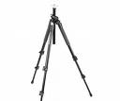
Equipment

Slide 8
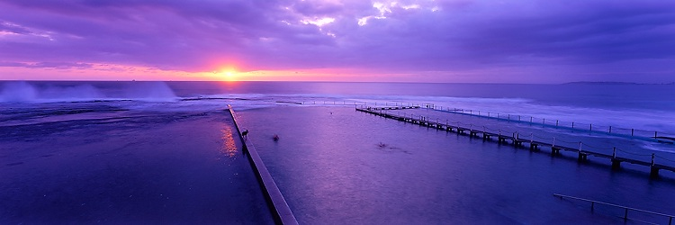
Considerations
Picture composition
Travelling through the image
What caught my eye
What is in the image
Light across the image
Is this the right spot to take the image?

Slide 9
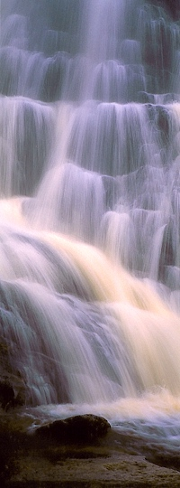
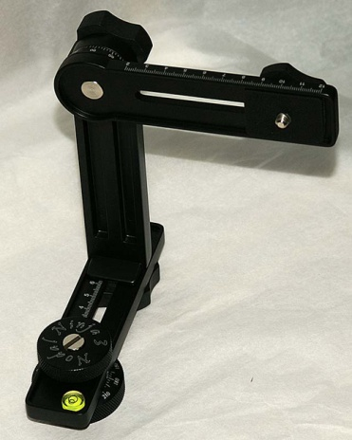
Taking the Picture
Secure the camera
Set the camera to manual exposure
Overlap
Lens zoom setting
Lens aperture setting
Important detail is the centre of image
Portrait or Landscape
Notes:
Secure the camera – use a tripod and level it carefully
You could use a Virtual reality head.
Manual exposure
Set the camera to manual exposure and expose all the images using the same aperture and shutter speed settings. As far as you can, select an average exposure, one that will be suitable for the complete scene.
Allow for ample overlap between frames – at least a quarter of the image width to be safe.
Lens Set you len’s zoom to the middle of its range between wide angle and telephoto. This setting is likely to produce the most even illumination of the whole image field and also the least distortion.
If possible set the lens to a small but not the smallest aperture say f11. Larger apertures result in unevenness of illumination in which the image is fractionally darker away from the middle.
Important detail – a distinctive building for example is in the middle of a shot not an overlap.
Portrait or Landscape orientation

Slide 10
Landscape Orientation

Slide 11
Portrait Landscape

Slide 12
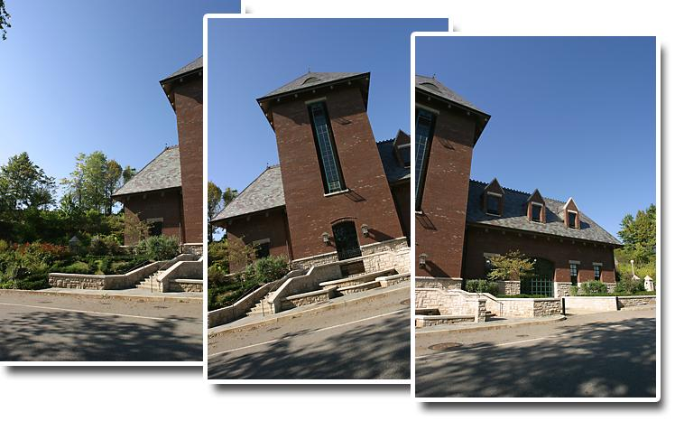
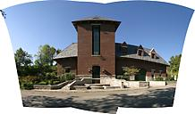
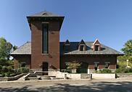
Software
Photoshop CS
The Panorama Factory
Panowaever
Panorama Builder 7.0
Autostitch
D Joiner
Double Take
Stitching

Slide 13
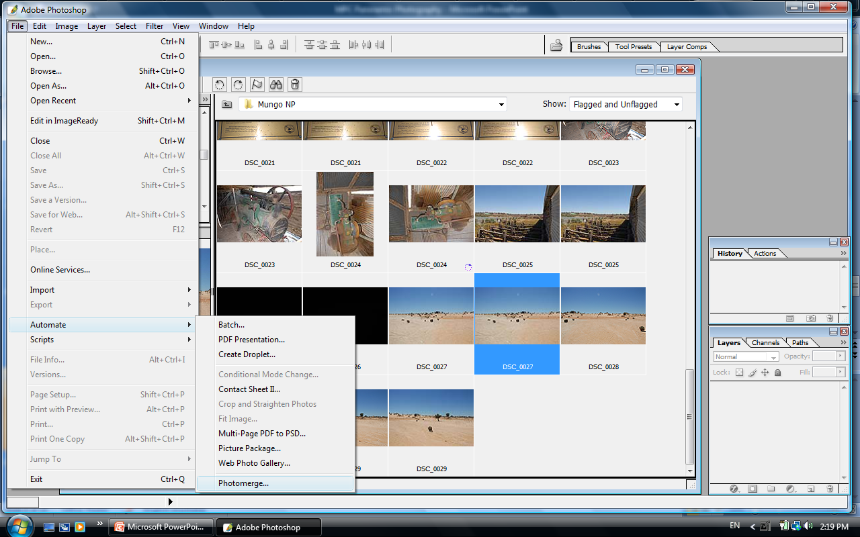
Merging / Stitching
Notes:
I have three landscape images all with the same lens focused at the same distance using the same exposure. Place all the images into the folder you work in and labelled as you see fit.
Go to File > New Photomerge to open the Photomerge command dialog.
Use the Browse button to navigate to the folder containing the images

Slide 14
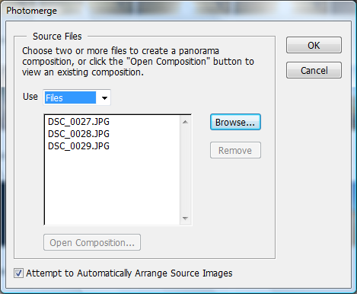
Notes:
Select the files for the photomerge.
Remove any files in the list that are not part of the panorama. Highlight them then select the Remove Button.

Slide 15
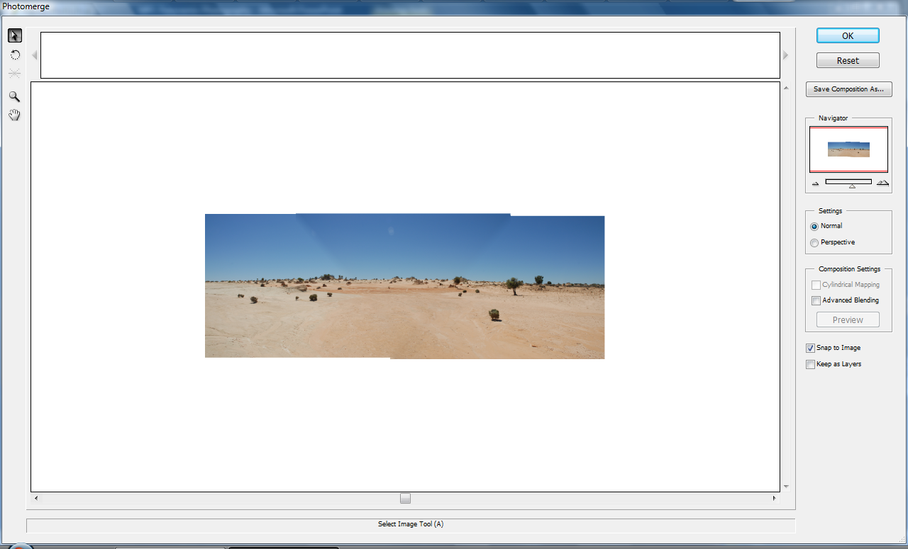
Notes:
Photomerge will start to assemble the images and will eventually open a dialog window where you will see the images stitched together in a prview panel. Any images that the software cannot handle will be displayed above the preview in a separate panel.
If there are any images that have not been stitched, drag them into the correct position from the top panel onto the preview panel and align them visually. The software should snap them into place. Use the Navigator area to zoom into the preview and manually adjustd the image position as necessary.

Slide 16
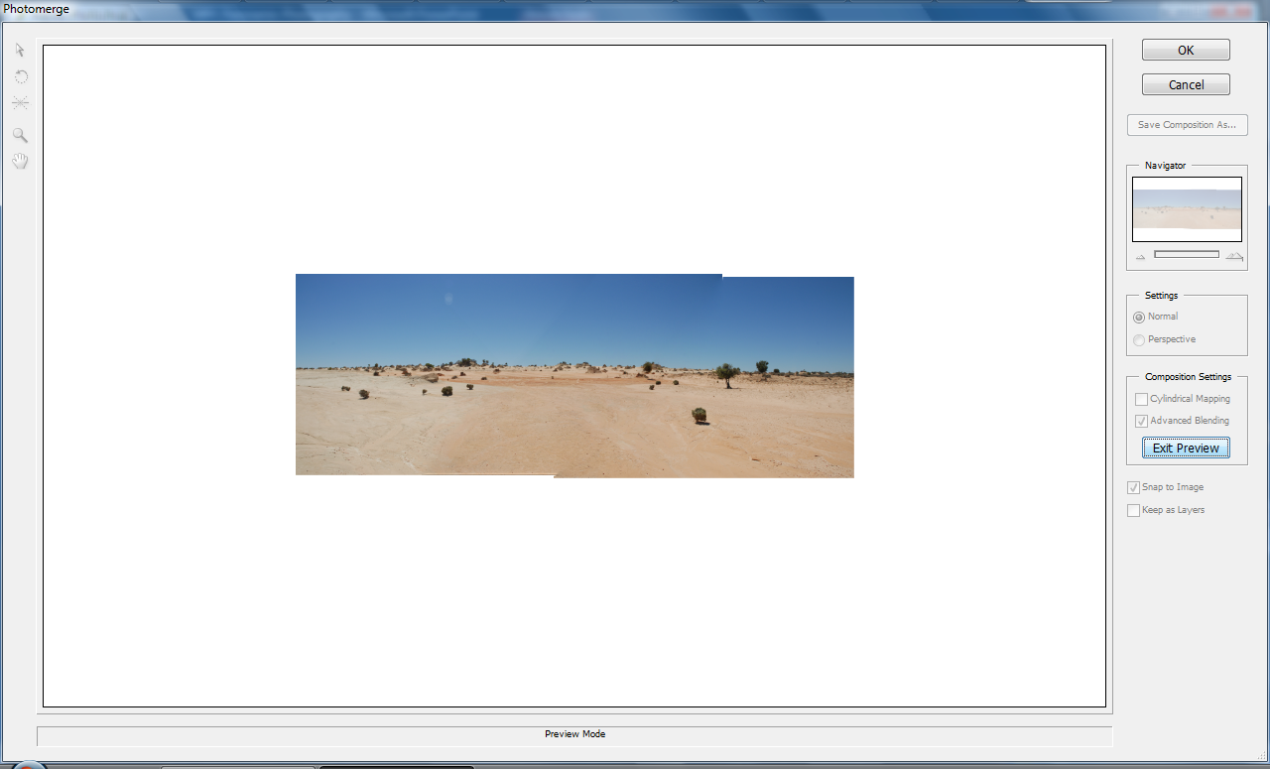
Notes:
Click the Advanced Blending check box so the software will do the best job possible of correcting any discrepancies between the images. Click Exit Preview to see the results when ready. Click OK to make the panorama.

Slide 17
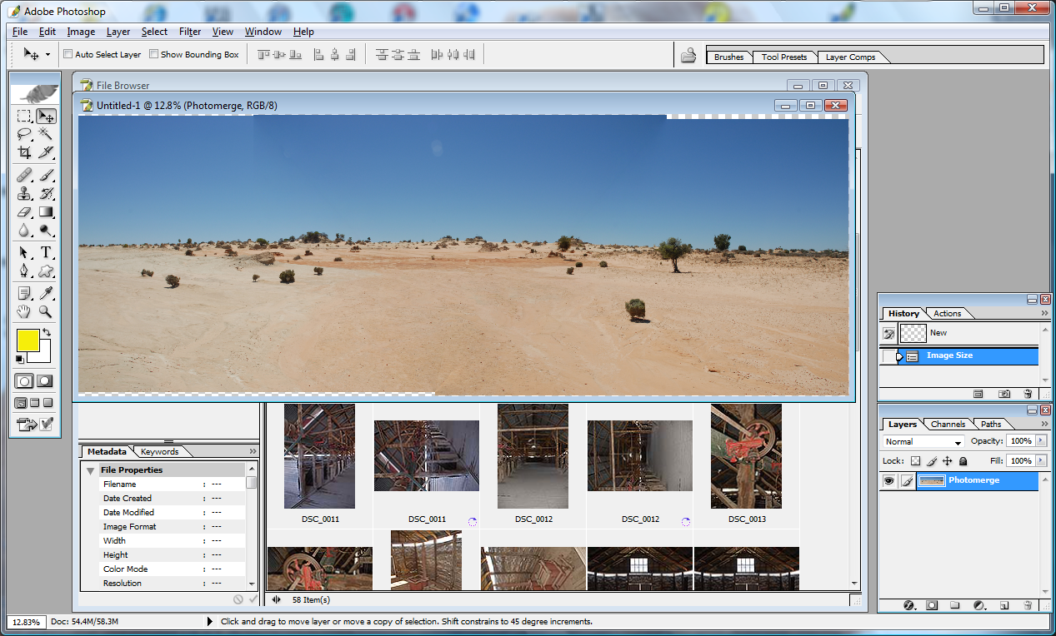
Notes:
Now carefully examine the image for any problems caused by stitching process. It is very rare to be perfect at this stage.

Slide 18
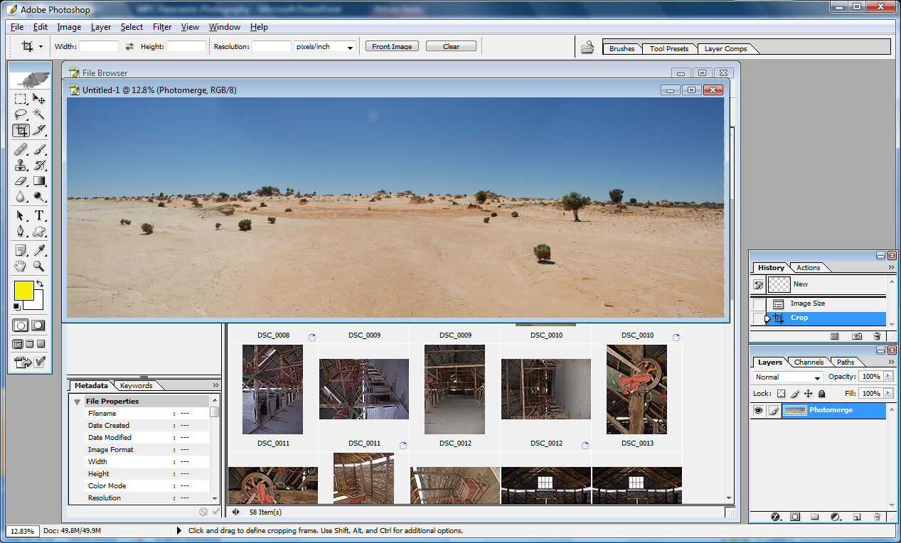

Slide 19
Summary

